Slide 1
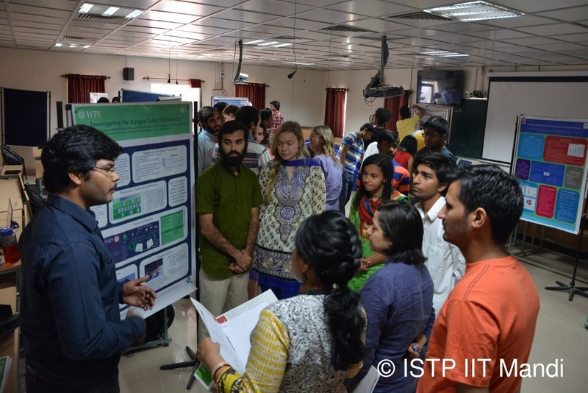

Introduction to ISTP 2024

Slide 2
What is ISTP?
Course Name: Interactive Socio-Technical Practicum (ISTP)
Course Code: DP301P
Credits: 4 credit-course
Students intended for: B.Tech. (3rd year – all branches)
Category: Elective
Pre requisite: Successful completion of 2nd year Design practicum (IC201P)
Basket: Design and Innovation
Mandatory course for students aspiring to a B.Tech (Hons.) degree

Slide 3
Why ISTP?
I
Development of useful products and technologies requires an understanding of the socio-economic context in which they will be used.
Introduction of a technology in a society often changes the society.
Therefore, essential that the technology leaders of tomorrow understand the interaction of society and technology.
Problems in society often require simple solutions and can be resolved easily with the right technological intervention.

Slide 4
Why ISTP?
II
On a higher plane, ISTP is intended to
Sensitize students with the problems around them in their society
Develop a sense of responsibility by being the solution provider
Nurture the qualities required to become an excellent engineer or technocrat who contributes to society in a variety of ways
Overall objective: to make a positive contribution to our community

Slide 5
What do ISTP students do?
Explore the various issues/problems of society.
Propose technology-based solutions for these.
Evaluate the proposed solutions from the:
Social
Technical
Economic
Environmental
and other aspects.

Slide 6

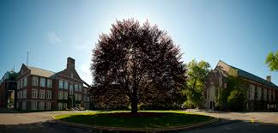
ISTP students collaborate with students from WPI, USA
https://www.wpi.edu/

Slide 7
Class Methodology
Pre-Prep
Beginning from January onwards, students will start working closely with their mentors
Lectures
All lectures will be covered from January to early March.
Field work
Field work is supposed to be done outdoors, wherein the students interact with the society.
Maintain uniform notebooks for data collection (notebook to be submitted at the end of the semester).
Use audio recordings, video recordings, photos, etc. (to be submitted at the end of the semester).
Document the work well in a structured way!
Meeting with faculty mentors
Have periodical meetings with the faculty mentors and discuss the project.
Feedback from coordinators
There will be opportunities for presentation of your work where you will get feedback from coordinators.

Slide 8
Tentative Lecture Schedule
Date | Topic
19 Jan | What is Research? Introduction to ISTP
2 Feb | Writing the Introduction
9 Feb | Literature Review
16 Feb | Quantitative Methods
23 Feb | Research Outcomes and Ethics
1 March | Qualitative Methods
8 March | Quiz 1: 25% of the grade
Time: 2-4pm, A18-2

Slide 9
Evaluation Pattern
Quiz 1: 25% [based on 1 credit course module]
Presentation and Paper Submission: 75% [ for 3 credit practical component]
------
Total 100%
*Attendance requirement 80% including scheduled lectures and workshops.

